Slide 1


Keith McDonald
8/23/24

Slide 2

Outline
Executive Summary
Introduction
Methodology
Results
Conclusion
Appendix

Slide 3
Executive Summary
Publicly available data retrieved from SpaceX website API and Webscraping Wikipedia
Data Evaluation included grphical analysis, SQL querries, geospatial analysis, and a Dash Board was created.
Attributes that correlate with Successful or Failed landings were identified.
Data was modelled using common classification models = Logistic Regression, Support Vector Machine, Decision Tree, K-Nearest Neighbors.
The model that best predicts a Successful or Failed landing was the Decision Tree Model.

Slide 4
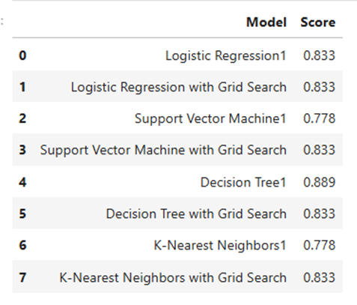
Executive Summary
Summary of Models Evaluated and Accuracy Scores. Decision Tree1 model was the best performing with 89% accuracy.

Slide 5
Introduction
SpaceX was the first to organization to successfully recover and reuse the 1st stage of a rocket.
SpaceX has greatly reduced the cost of launching satellites because of their ability to recover and reuse the 1st stage of a rocket.
The cost of launching a satellite or vehicle into orbit remains highly dependent on whether the 1st stage can be recovered.
Can known data about a launch vehicle be used to predict whether 1st stage recovery will be successful?
What data is needed to predict whether the 1st stage will be recovered?
What models can be used to predict the 1st stage recovery?
How accurate are the prediction models?

Slide 6

Section 1

Slide 7
Methodology
Executive Summary
Data collection methodology:
Data collected from 2 sources from the period 2010 to 2020:
SpaceX API from https://api.spacexdata.com/v4/launches/past
Web Scraping from Wikipedia https://en.wikipedia.org/w/index.php?title=List_of_Falcon_9_and_Falcon_Heavy_launches&oldid=1027686922
Data included Launch Site, Payload Mass, Grid Fins, Legs, Booster Version, and Landing Outcome
Perform data wrangling
Records with null data removed, Falcon 1 data removed
Evaluated data types to ensure compatible with models
One-Hot Encoding – Convert True/False to 1 / 0

Slide 8
Methodology
Executive Summary
Perform exploratory data analysis (EDA) using visualization and SQL
Perform interactive visual analytics using Folium and Plotly Dash
Perform predictive analysis using classification models
Load data into a Data Frames for independent and dependent variables
Standardize data
Split into Training and Test data.
Load data into Models
Evaluate models using Confusion Matrix and statistical scoring

Slide 9
Data Collection – SpaceX API
Data collected from SpaceX REST API from
http://api.spacexdata.com/v4/launches/past
Query data using requests.get(url)
Once a successful response is received, data is parsed into readable data frame and desired data is tabulated using Pandas and Numpy modules.
Data is saved in .csv format for future use.
IBM-Capstone/jupyter-labs-spacex-data-collection-api.ipynb at main · KNMcD/IBM-Capstone (github.com)
Import Modules
Create Query / Get Request
Receive response (data) from Web Service
Parse Data into readable format
Create Data frame with desired data

Slide 10
Data Collection - Scraping
Data Scraped from website
https://en.Wikipedia.org/w/index.php?title=List_of_Falcon_9_and_Falcon_Heavy_launches&oldid=1027686922
Query data using requests.get(url)
Once a successful response is received, data in html format is parsed using Beautiful Soup module
Desired data is tabulated and given Column headings in a data frame using Pandas module.
Data is saved in .csv format for future use.
IBM-Capstone/jupyter-labs-webscraping.ipynb at main · KNMcD/IBM-Capstone (github.com)
Import Modules
Call website using Get Request
Receive response (html) from Web Site
Parse Tables/Columns into readable format using Beautiful Soup Object
Create Data frame with desired data

Slide 11
Data Wrangling
Data loaded from .csv file
Evaluate data types and any missing data
Evaluate the type/count of each
Launch Site
Orbit Type
Landing Outcomes
Create a set of bad landing outcome
Create new ‘Class’ Column for classification
Failed = 0
Successful = 1
Save Data in .csv file
IBM-Capstone/labs-jupyter-spacex-Data wrangling.ipynb at main · KNMcD/IBM-Capstone (github.com)
Import Modules
Import Data from .csv file
Evaluate data types/null data
Evaluate/Aggregate data into groups
Create new ‘Class’ Column for Classifying Landing Outcomes

Slide 12
EDA with Data Visualization
Summary of Charts used
Payload Mass vs. Flight Number with hue = Class
Launch Site vs. Flight Number with hue = Class
Launch Site vs. Payload Mass with hue = Class
Class Mean vs. Orbit
Orbit vs. Flight Number with hue = Class
Orbit vs. Payload Mass with hue = Class
Success Rate vs. Year
IBM-Capstone/jupyter-labs-eda-dataviz.ipynb at main · KNMcD/IBM-Capstone (github.com)

Slide 13
EDA with SQL
Summary of SQL Queries
Names of unique Launch Sites
5 Records with Launch Site beginning with ‘CCA’
Total Payload Mass launched by NASA (customer)
Average Payload Mass by booster version ‘F9 v1.1’
Data of first successful landing on ground pad
Names of boosters with successful drone ship landings with Payload mass between 4000 and 6000 Kg.
Total number of Successful/Failed mission outcomes
Booster versions that carried the Maximum Payload mass
Months in 2015 where Landing Outcome was a drone ship failure
Rank Landing Outcomes by count between 6/4/2010 and 3/20/2017
IBM-Capstone/jupyter-labs-eda-sql-coursera_sqllite.ipynb at main · KNMcD/IBM-Capstone (github.com)

Slide 14
Build an Interactive Map with Folium
Folium Map Objects used
Circles used to mark the Launch Site locations
Markers used to label the name of Launch Site locations - Vandenburg AF Base, Cape Canaveral, Kennedy Space Center, etc.
Marker Clusters used to mark the Launch Locations of Successful Launches (green) and Failed Launches (red)
https://nbviewer.org/github/KNMcD/IBM-Capstone/blob/main/lab_jupyter_launch_site_location.ipynb
IBM-Capstone/lab_jupyter_launch_site_location.ipynb at main · KNMcD/IBM-Capstone (github.com)

Slide 15
Build a Dashboard with Plotly Dash
Dashboard Features Summary
Dropdown of Launch Sites
When All Sites selected displays Pie Chart with Percentage of Successful launches by Site
When specific Launch Site selected displays Pie Chart with Percentage breakdown of Successful/Failed launches
Scatter Chart of Successful Launches versus Payload Mass for All Sites or selected Launch Site
Featured with Range Slider to specify Minimum and Maximum Payload Mass
Dropdown and Range Slider allow analysis of Successful / Failed based on Launch Site and Payload Mass.
IBM-Capstone/dash_interactivity.py at main · KNMcD/IBM-Capstone (github.com)

Slide 16
Predictive Analysis (Classification)
Classification Analysis
Data loaded and split into Independent variables (X) and Dependent variables (Y)
Data Standardized using Standard Scalar function.
Data split into train and test data sets with 20% randomly selected as test data.
Training data used to train model with and without utilizing GridSearchCV function.
Models included - Logistic Regression, Support Vector Machine, Decision Tree Classifier, K-Nearest Neighbors,
IBM-Capstone/SpaceX_Machine_Learning_Prediction_Part_5.jupyterlite2.ipynb at main · KNMcD/IBM-Capstone (github.com)

Slide 17

Section 2

Slide 18
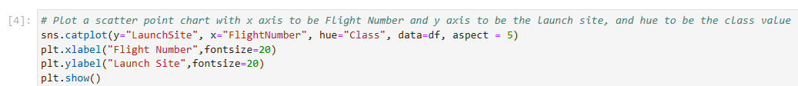
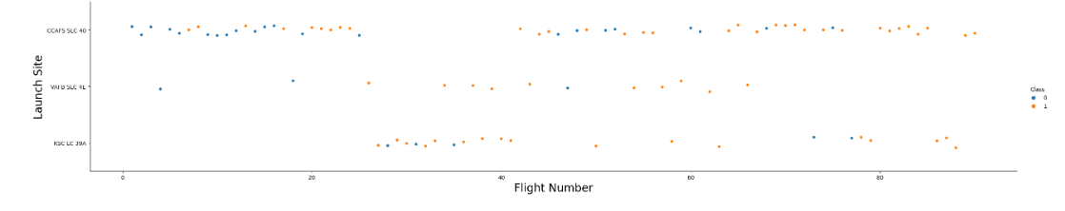
Flight Number vs. Launch Site
Successful launches (Class = 1) indicated in orange, Failed launches (Class=0) indicated in blue.
Later flights were more likely to be successful. Earliest flights were mostly failures.
Largest number of flights were from Cape Canaveral with least number of flights from
Vandenburg AF Base.

Slide 19
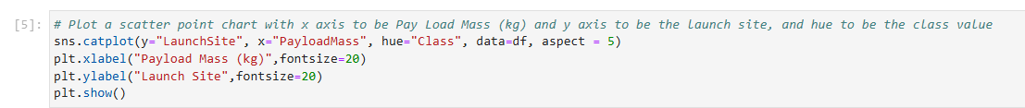
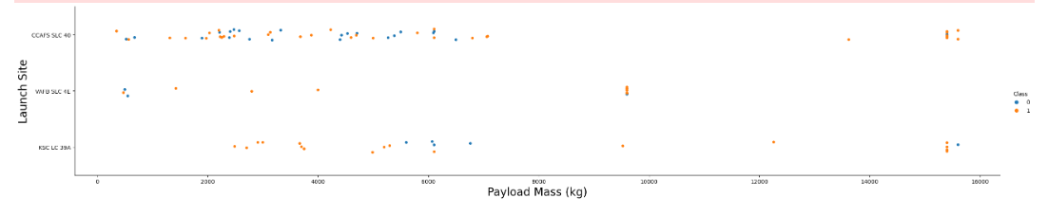
Payload vs. Launch Site
Successful launches (Class = 1) indicated in orange, Failed launches (Class=0) indicated in blue.
Heavier Payload Mass were more likely to be Successful
No launches from Vandenburg AF Base greater than 10,000 Kg.
Majority of Payloads are less than 10,000 Kg.

Slide 20
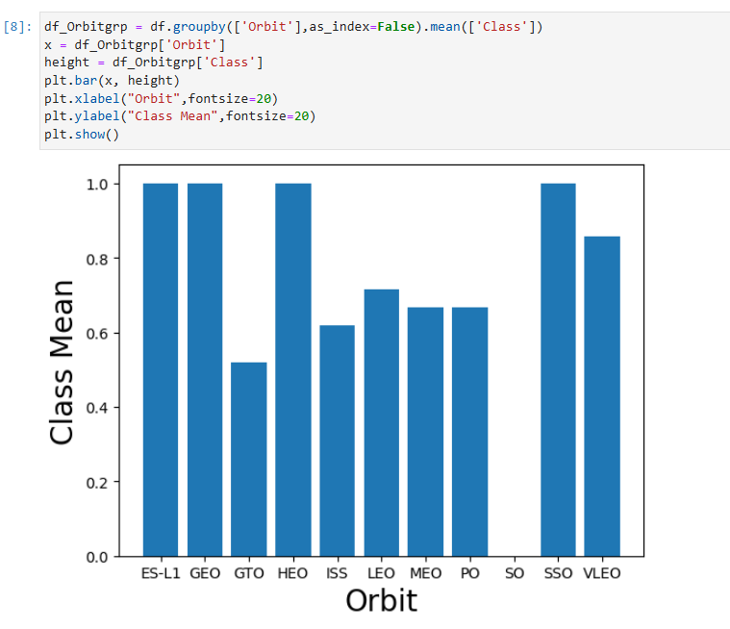
Success Rate vs. Orbit Type
Orbit types that are most likely to be Successful – ES-L1, GEO, HEO, SSO
Orbit type that is least likely to be Successful – GTO
No SO Orbit types were attempted.

Slide 21
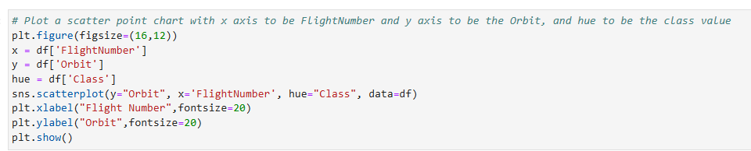
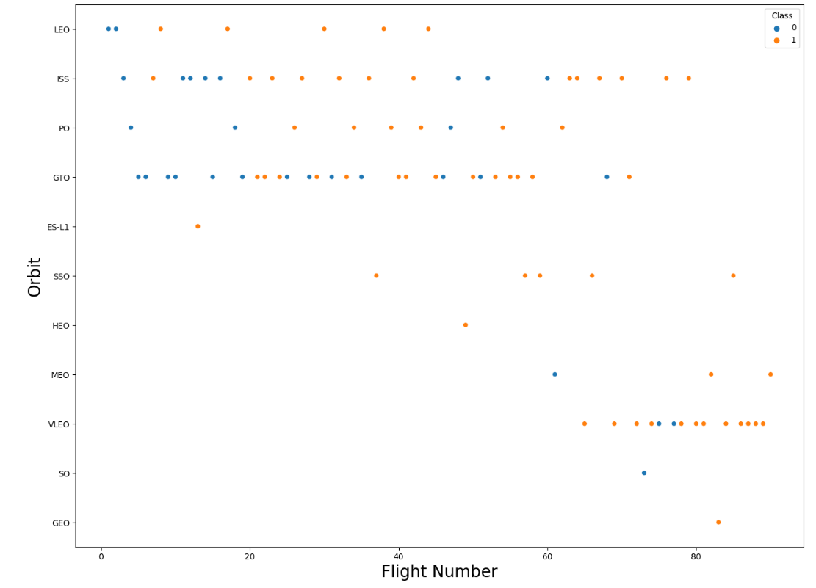
Flight Number vs. Orbit Type
Successful launches (Class = 1) indicated in orange, Failed launches (Class=0) indicated in blue.
Later flights were more likely to be Successful. GTO Orbit least likely to be Successful

Slide 22
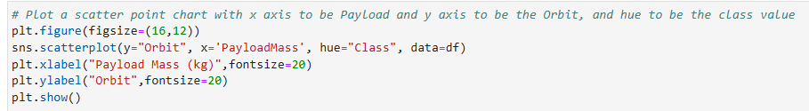
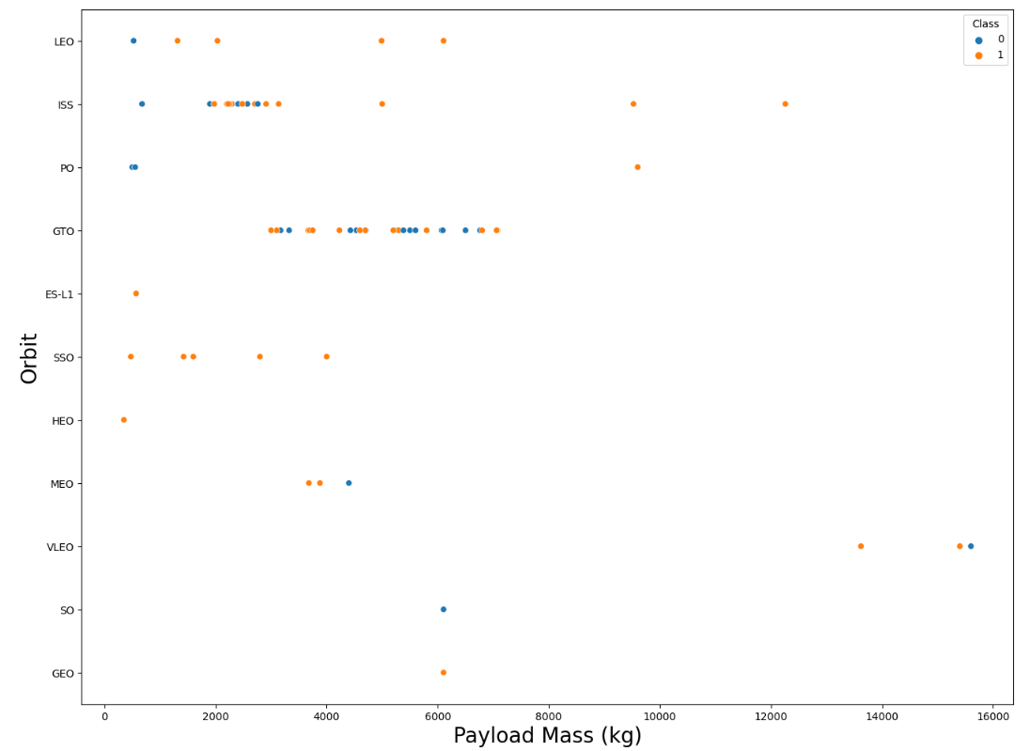
Payload vs. Orbit Type
Successful launches (Class = 1) indicated in orange, Failed launches (Class=0) indicated in blue.
Heavier Launches more likely to be successful.

Slide 23
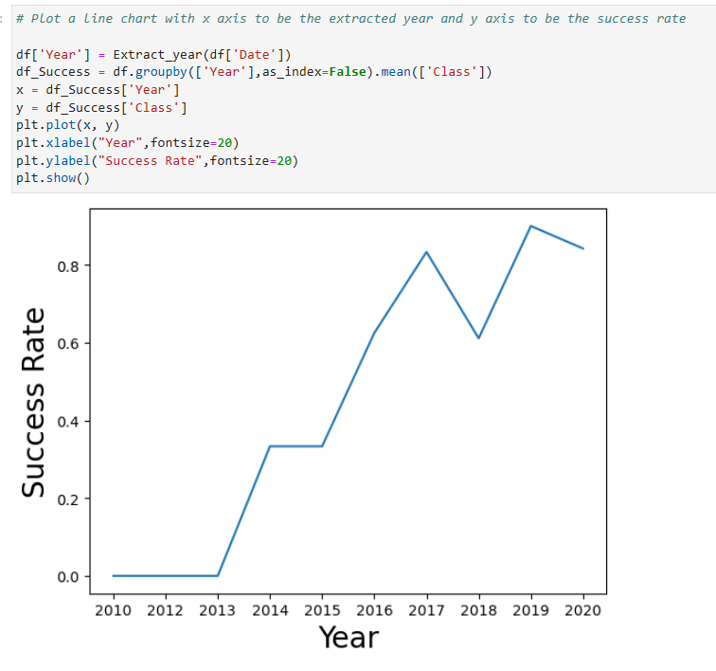
Launch Success Yearly Trend
Success Rate improves over time starting in 2013.
Success Rate improves to > 80% by 2019.

Slide 24
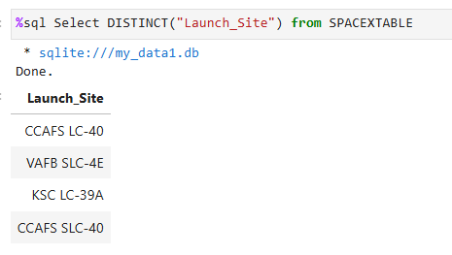
All Launch Site Names
There are 4 unique Launch Sites.

Slide 25
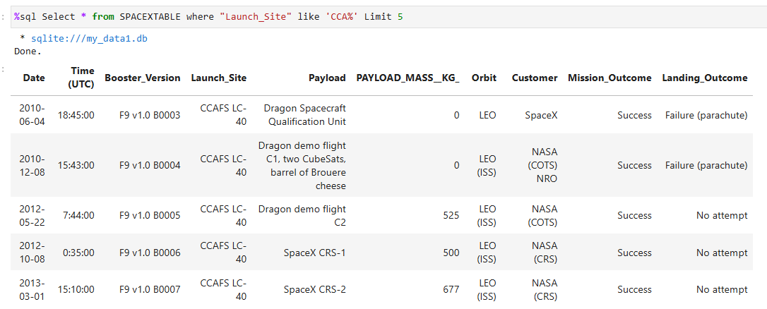
Launch Site Names Begin with 'CCA'
First 5 records with Launch Site starting with ‘CCA’

Slide 26
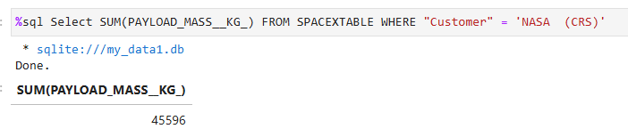
Total Payload Mass
Total Payload Mass in Kg carried with NASA as the Customer.

Slide 27
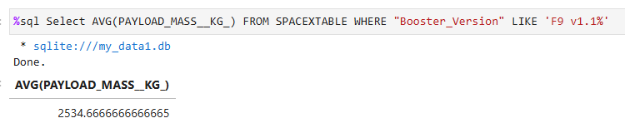
Average Payload Mass by F9 v1.1
Average payload mass carried by booster version F9 v1.1 in Kilograms.

Slide 28
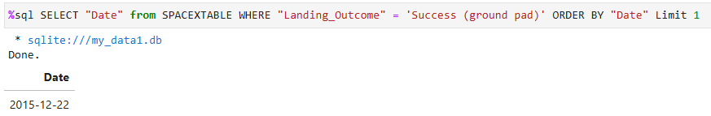
First Successful Ground Landing Date
First Successful ground landing – Query selects all Successful ground landings, then orders by date ascending, limits query to the first record.

Slide 29
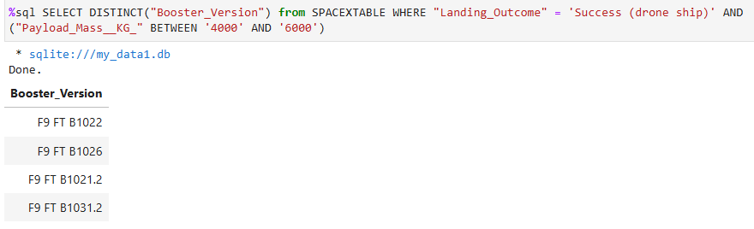
Successful Drone Ship Landing with Payload between 4000 and 6000
Boosters which have successfully landed on drone ship and had payload mass 4000 - 6000 Kg.

Slide 30
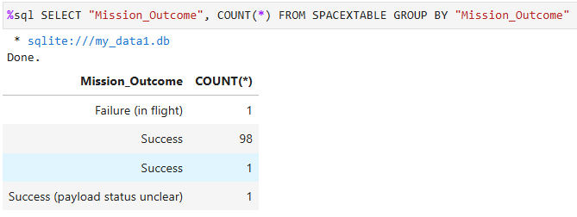
Total Number of Successful and Failure Mission Outcomes
Total number of successful and failure mission outcomes

Slide 31
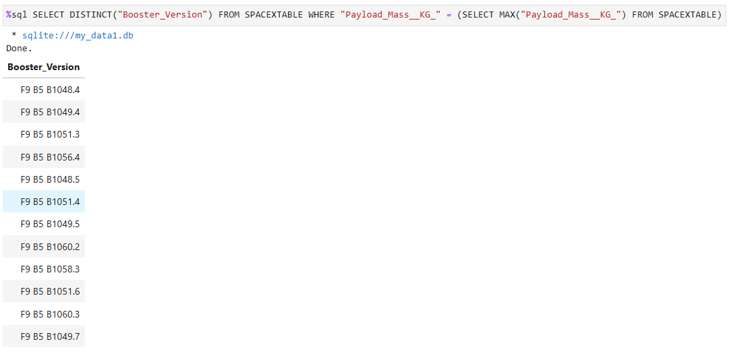
Boosters Carrying Maximum Payload
12 different booster versions have carried the maximum payload mass

Slide 32
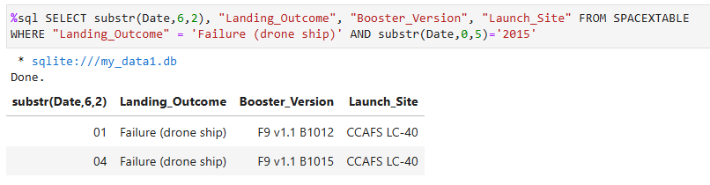
2015 Launch Records
Failed landing_outcomes in drone ship, their booster versions, and launch site names for in year 2015

Slide 33
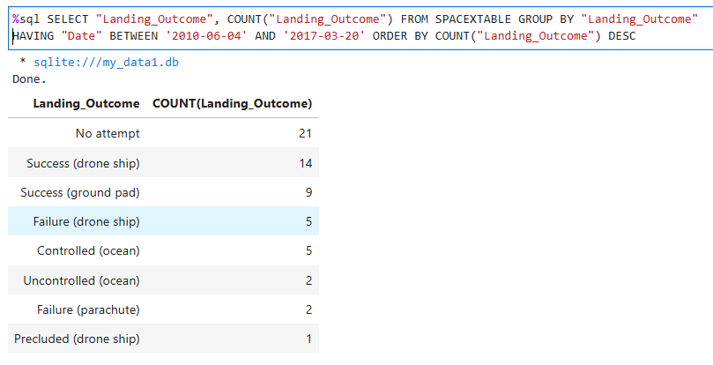
Rank Landing Outcomes Between 2010-06-04 and 2017-03-20
Rank the count of landing outcomes (such as Failure (drone ship) or Success (ground pad) between the date 2010-06-04 and 2017-03-20, in descending order

Slide 34

Section 3

Slide 35
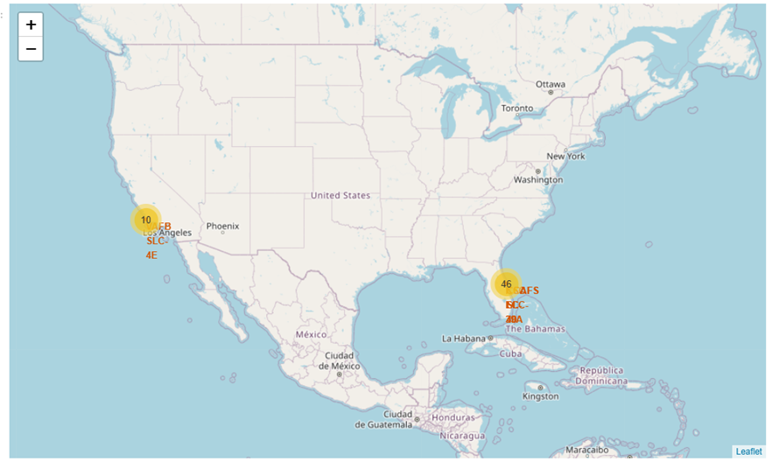
Space X Launch Sites – World Map
Map showing Marker Clusters of Launch Sites at Vandenburg AF Base, Cape Canaveral, Kennedy Space Center Pad 39A and 39B.

Slide 36
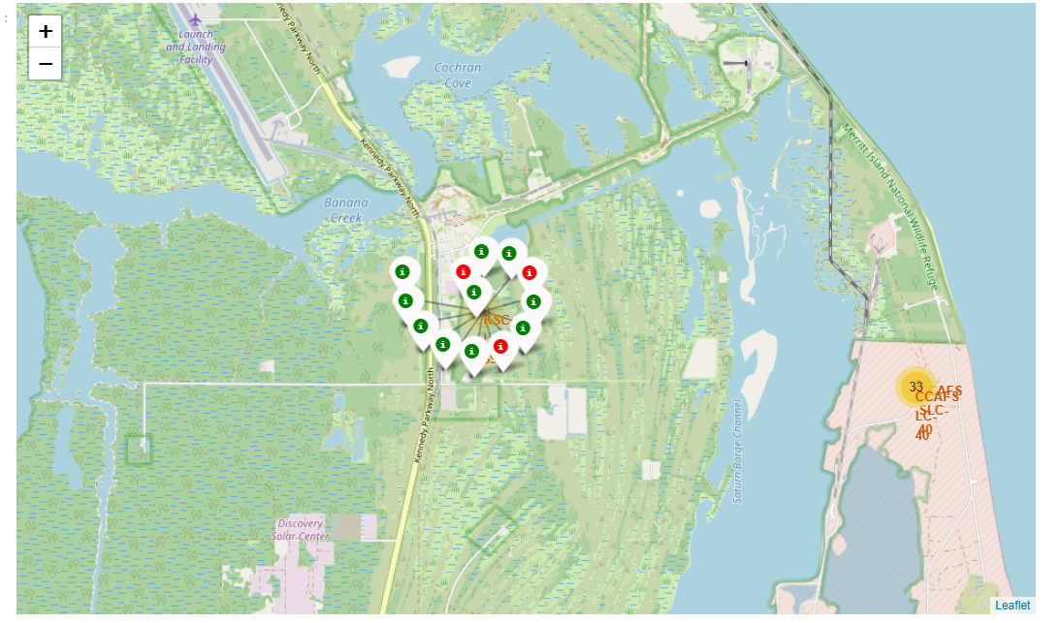
Space X Launch Sites – World Map
Folium map showing Kennedy Space Center launch Site with Successful launches (green) and Failed launches (red).
Data column for marker color was generated.
For loop iterates through marker colors to place appropriate colored marker on the map.

Slide 37

Section 4

Slide 38
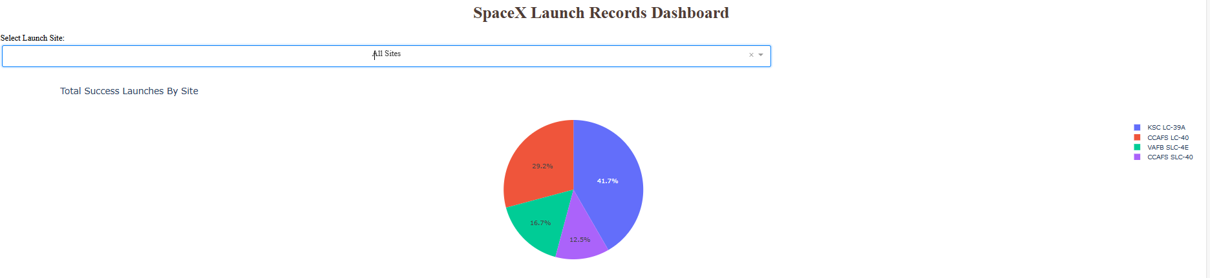
SpaceX Launch Records Dashboard
Pie Chart showing Successful launches grouped by Launch Site
Legend to right shows Launch Site color code.
Largest percentage of Successful launches are from KSC-LC39A

Slide 39
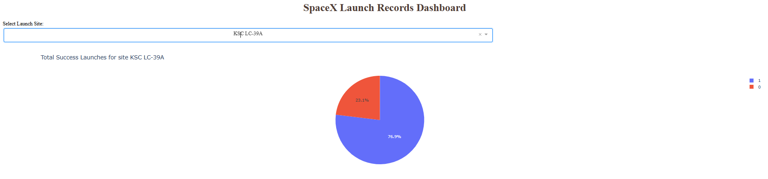
Dashboard updated with KSC LC-39A Selected
Pie Chart of KSC LC-39A showing percentage of Successful and Failed Launches
Legend to right indicates Success = 1 (blue), Failed = 0 (red).

Slide 40
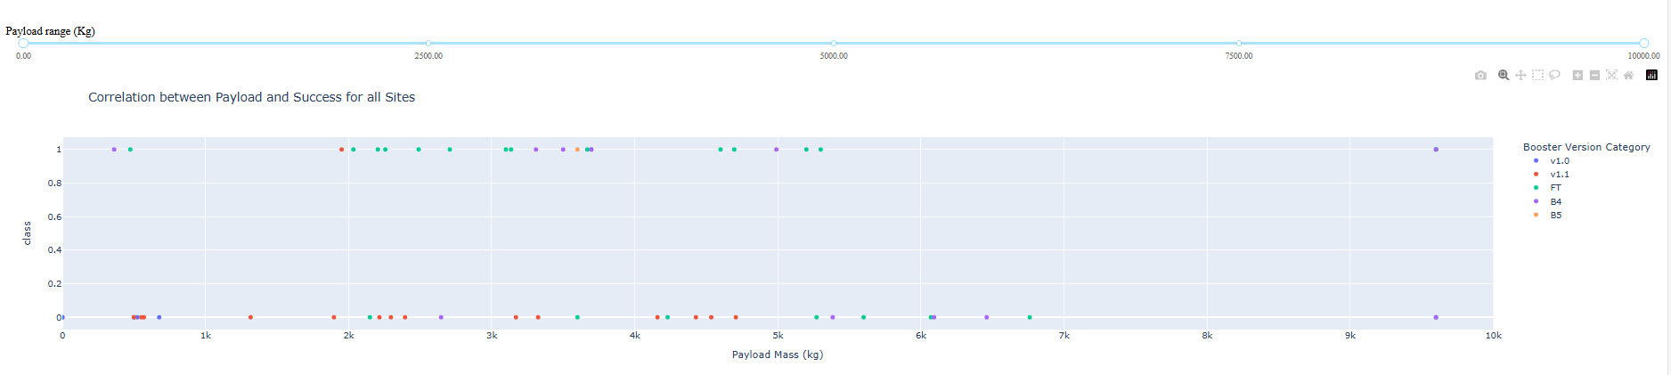
Scatter Plot of Payload Mass vs. Launch Outcome
All sites selected showing most Payload Masses are less than 7000 Kg.
Legend on right shows Booster Version color code.
Most Successful Booster Version is FT.

Slide 41
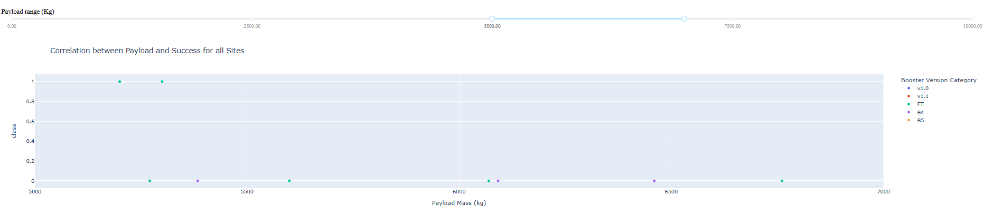
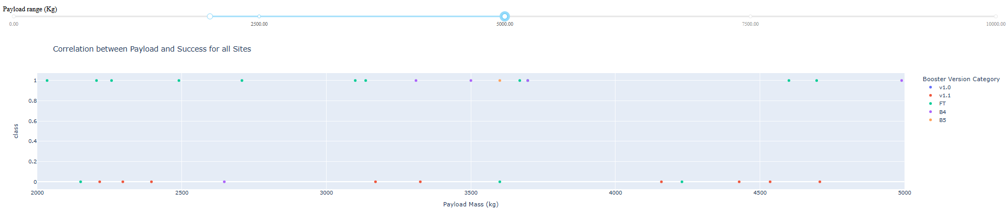
Dashboard Updated showing various Payload Ranges
Least Successful Payload range is approximately 5000 Kg to 7500 Kg.
Most Successful Payload range is approximately 1500 Kg to 4000 Kg.

Slide 42
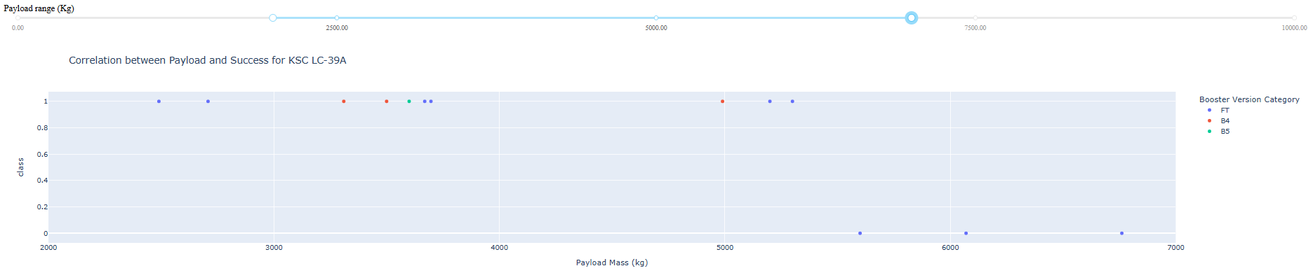
Most Successful Launch Site – KSC LC-39A
Scatter Plot updated with Launch Site KSC LC-39A showing all Payloads ranged from 2000 Kg to 7000 Kg.
10 Successful launches out of a total of 13 launches.
Booster Versions B4 and B5 had no Failed launches from KSC LC-39A.

Slide 43
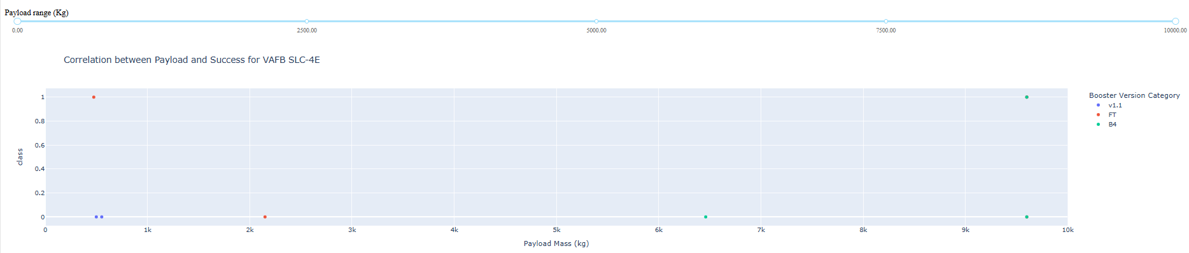
Least Successful Launch Site - VAFB
Scatter Plot updated with Launch Site VAFB showing all Payloads ranged from 0 Kg to 10,000 Kg.
2 Successful launches out of a total of 7 launches.

Slide 44

Section 5

Slide 45
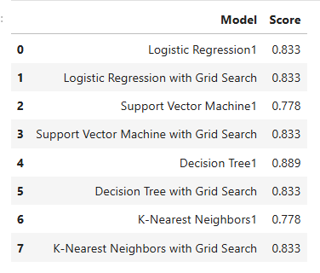
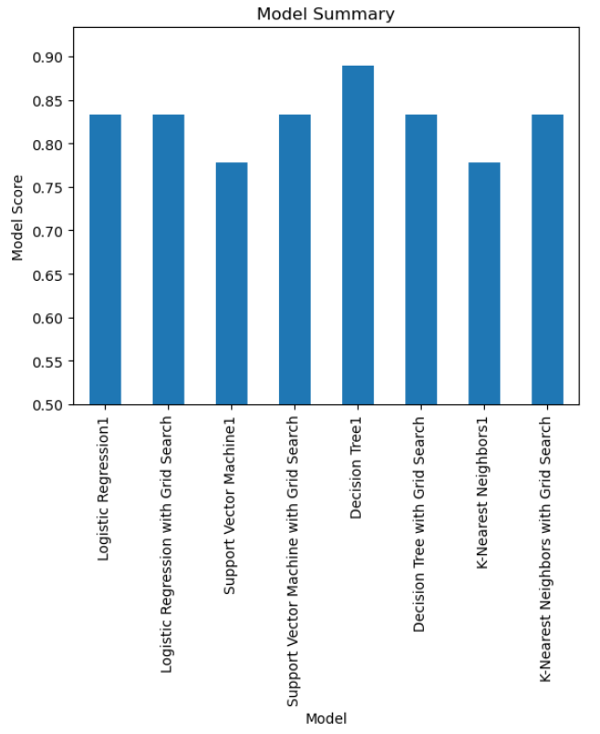
Classification Accuracy
Model Accuracy Summary table and Bar Chart
Decision Tree Model with default parameters was the most accurate at classifying Launch Success.

Slide 46
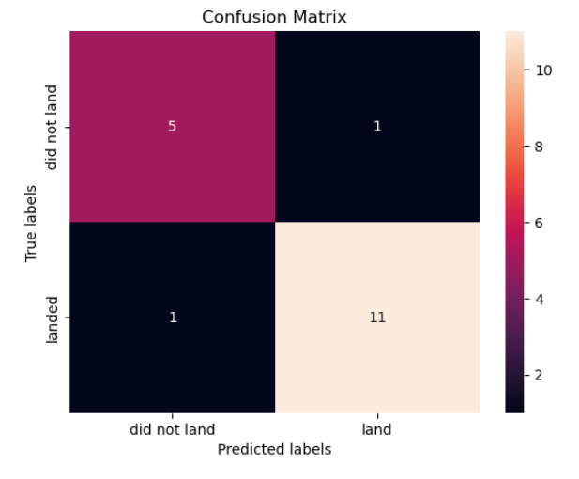
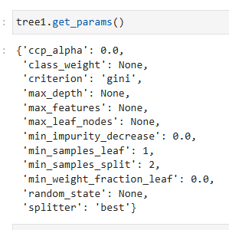
Confusion Matrix
Decision Tree Confusion Matrix showing actual versus predicted results for the Decision Tree Model using the following model parameters to the right.

Slide 47
Conclusions
Falcon 9 booster landing success can be predicted with approximately 89% accuracy using Decision Tree Classification Model.
Important attributes that affect landing success are the Launch Site, Payload Mass, Orbit, and booster version.
Landing Success has improved over time with > 80% success rate after 2019.

Slide 48
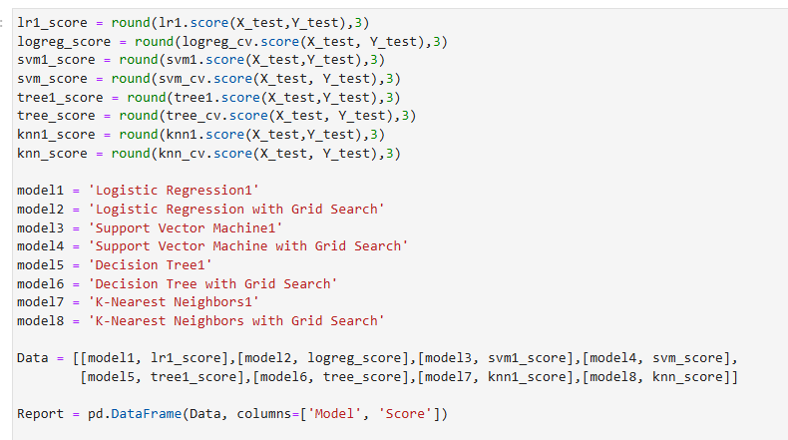
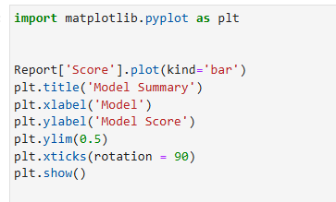
Appendix
Code used to Summarize and plot Model results.

Slide 49


